Slide 1
The Golden Rule
Dr. Adam C. English
Department of Christian Studies
“Golden Rule Ethics Applied to Relational Models,” Perspectives in Religious Studies 50.3 (Fall 2023), 375-390
Campbell University

Slide 6
Breaking down the Golden Rule
German philosopher Hans Reiner (1896-1991) published research on the Golden Rule for thirty years: 1948, 1964, and 1977
Reiner identified
specific moral principles
that constitute the Rule

Slide 7
1. principle of sympathetic projection
1. the Einfühlungsregel or “principle of sympathetic projection”
Put yourself in someone else’s shoes
(See Lisa Aziz-Zadeh’s research on mirror neurons and empathy)

Slide 8
2. principle of autonomous judgment
2. the Autonomieregel “principle of autonomous judgment”
“autonomous” in the sense of self-evident
Anyone can see and judge your actions
(see Joshua Greene’s fMRI-based studies on the Trolley Problem)

Slide 9
3. principle of reciprocity
3. the Rückbezüglichkeitsregel “principle of reflexivity” or “principle of reciprocity”
The Golden Rule calculates that the other person will, if treated in a particular manner, react in kind.
The idea comes close to a principle of retribution, but different because retribution is reactive, reciprocity is anticipatory
(see Robert Axelrod’s computer modeling of tit-for-tat strategies)

Slide 10
4. principle of risk
The Golden Rule involves the very real risk that your actions will not be reciprocated.
Risk-taking is constitutive of any moral action.
(see Lara Buchak’s work on the role of risk in rational choice games)

Slide 11
Lingering questions: Is there a difference between the positive and the negative formulation?
Negative formulation: abstain from action
Didache 1.2 “And whatever you do not want to happen to you, do not do to another.”
Positive formulation: take initiative
Matt 7:12 “In everything do to others as you would have them do to you; for this is the law and the prophets.”
Luke 6:31 “Do to others as you would have them do to you.”

Slide 12
Lingering questions: Is the Golden Rule restrictive or expansive?
Restrictive
Do to others only what you would have them do to you
Expansive
Do to others everything that you would have them do to you

Slide 13
Lingering questions: Is the Golden Rule the pinnacle of moral progress?
Albrecht Dihle (1923-2020) speculates on the historical evolution of the Golden Rule:
Human groups begin with indiscriminate blood revenge →
→ calculated retribution and compensatory punishment ( ius talionis, the “law of retaliation” ) →
→ the Golden Rule, negatively stated →
→ the Golden Rule, first positively expressed by Jesus

Slide 14
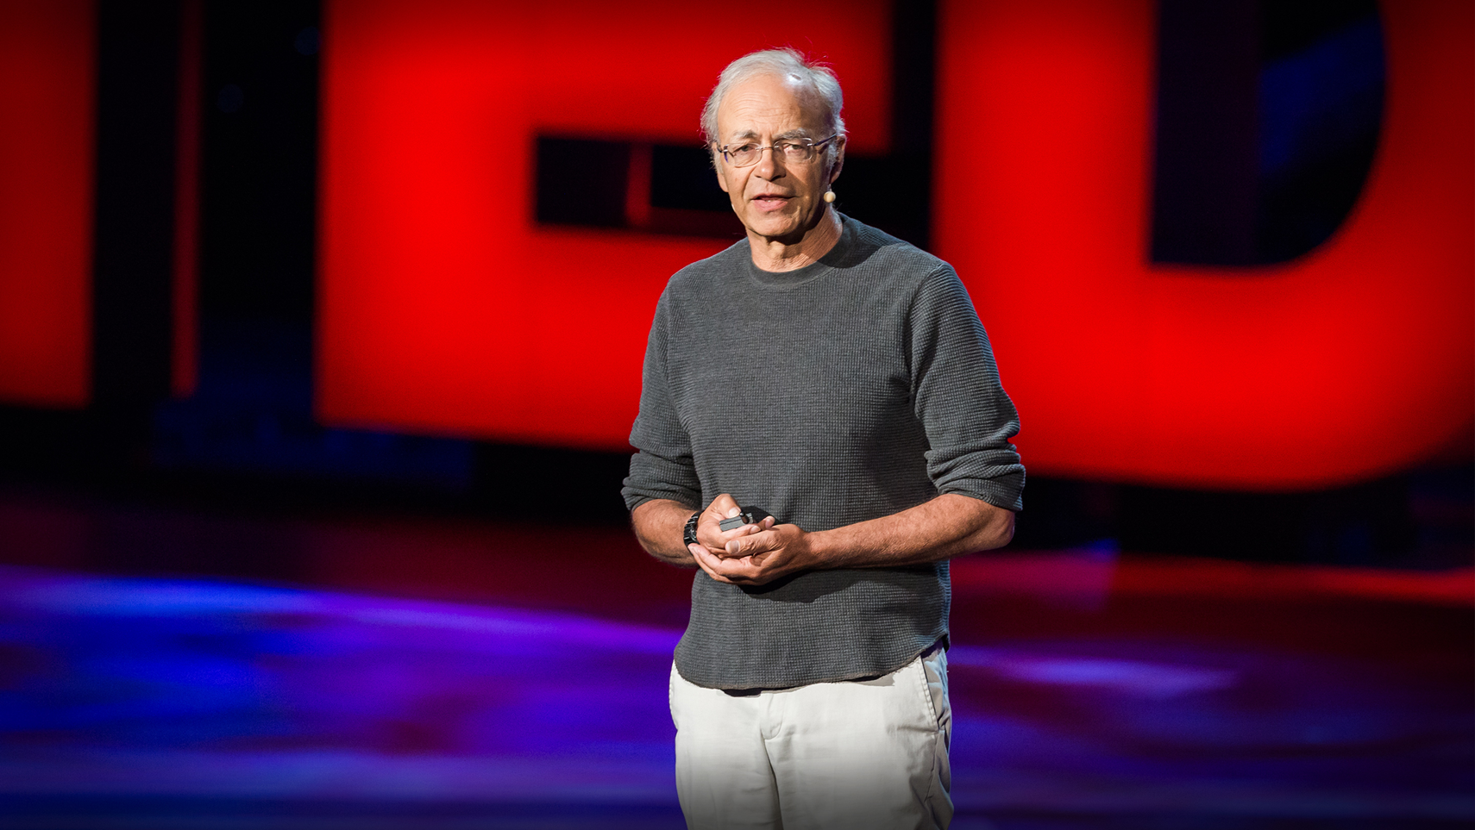
Peter Singer, The Expanding Circle
“Beginning to reason is like stepping onto an escalator that leads upward and out of sight. Once we take the first step, the distance to be traveled is independent of our will and we cannot know in advance where we shall end.”

